Slide 1



Circularities and Modularity in the Wild
Some F# Perspectives on Software Engineering
Don Syme (Microsoft Research)
Scott Wlaschin (fpbridge.co.uk, fsharpforfunandprofit.com)

Slide 2
Agenda
A bit about F#
Circularity and Modularity In The Wild
Tooling, Data and Type Providers

Slide 3
F# is open source, cross-platform, community-oriented fsharp.org #fsharp on Twitter meetup.com/FSharpLondon (on tonight!)

Slide 4
For this audience, F# is….
Core FP
Objects
Computations (async, …)
Type Providers for Data Integration
Interop (.NET, R, …)
Meta-programming
Cross-platform
Compiler as Service
Tooling
GPGPU
Parallel
Distribution
github.com/fsharp/fsharp
github.com/fsprojects/VisualFSharpPowerTools
github.com/fsharp/FSharp.Compiler.Service
github.com/fsharp/FSharp.Data

Slide 5
F# helps address real business problems for real businesses Time to Market, Efficiency, Correctness and Complexity See: “Succeeding with Functional-first Programming in Industry” See fsharp.org/testimonials

Slide 6
F# has changed…
F# runs on many platforms
“F# is for Windows”

Slide 7
F# has changed…
F# has many contributors
“Microsoft
makes F#”

Slide 8
F# has changed…
Many perspectives
http://fsharp.org
One perspective
(Microsoft’s)
http://msdn.microsoft.com

Slide 9
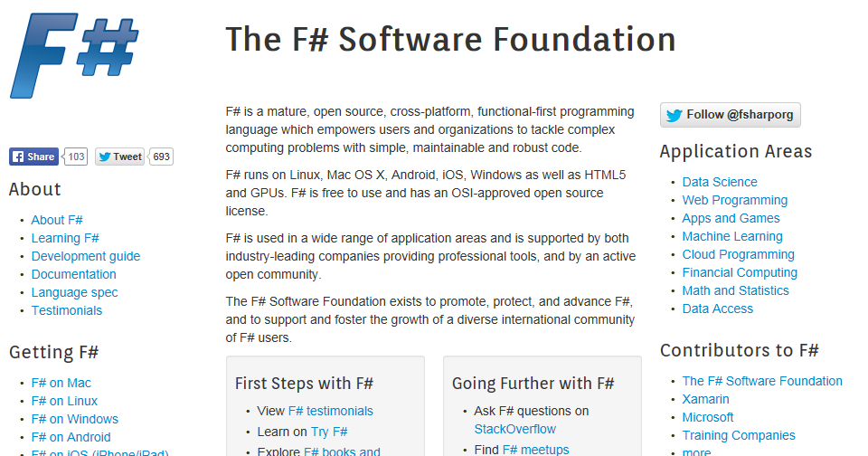
fsharp.org

Slide 10
Circularities and Modularity in the Wild Analysis by Scott Wlaschin and F# Community

Slide 11
Mixed OO/Functional Programming Has Won Lambdas in C#, Java, C++, … Async monadic modality in C#, Javascript, PHP (Hack), … Function types in C#, TypeScript, … Generics in C#, Java, Visual Basic, … …

Slide 12
… except where it hasn’t Inheritance everywhere!!! Nulls everywhere!!! Side effects everywhere!!!! Circularities everywhere!!!!

Slide 13
F# and Software Engineering
By accident, F# makes for an interesting, large-scale experiment in SE
Same runtime, JIT, GC, standard libraries, IDE, machines as C#
“FP v. OO Cage Match of Death” (though not really….)
Q: Does the structure of F# code differ from C# in practice?
Q: Does the language you use make a difference?

Slide 14
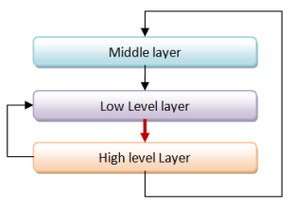
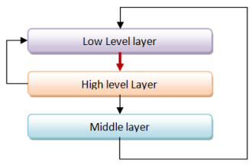
Unnecessary Circularities are Evil
To the functional programmer, it is “obvious” that our software methodology should help minimize and reduce cyclic dependencies in program structure.

Slide 15
The C# approach to circularity
All files in an “assembly” are mutually referential
Arbitrary circularity and dependency between “internal” items in an assembly
[InternalsVisibleTo] can reveal internals of one assembly to another
Mutually recursive “assemblies” are possible if you try hard

Slide 16
The F# approach to circularity
Like Haskell and all Hindley-Milner languages, F# has a file ordering
F# prohibits direct circularities across files
F# encourages minimizing dependencies within a file
Parameterization the preferred technique
F# objects support recursion and limited forms of circularity when needed

Slide 17
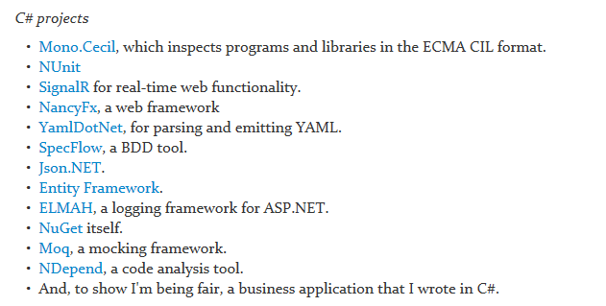
Let’s analyse some C# and F# projects

Slide 18
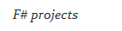
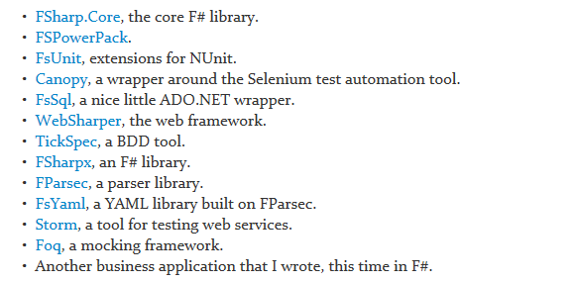
Let’s analyse some C# and F# projects

Slide 19
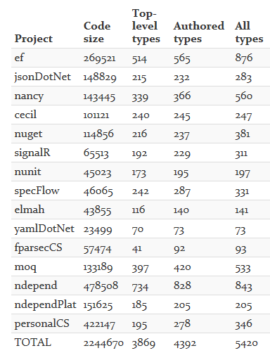
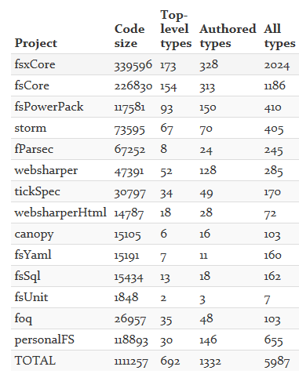
Sizes of projects

Slide 20
Metrics Used
A top-level type is: a type that is not nested and which is not compiler generated.
Roughly speaking, a count of user-defined types and modules
Code size is measured by IL instructions (not LOC)

Slide 21
How many top-level type definitions or modules?

Slide 22
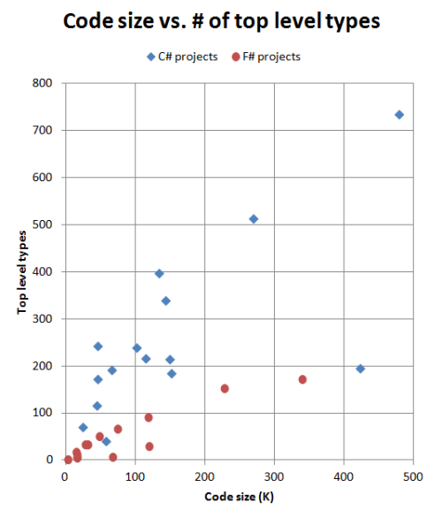
F# tends to have fewer type definitions or modules. C# projects have ~1-2 TTT/1K instructions. F# projects have ~0.6 TTT/1K instructions. Reasons: (a) functional abstraction is used more often (b) functions, discriminated unions etc. mean fewer type definitions and modules

Slide 23
What about dependencies?

Slide 24
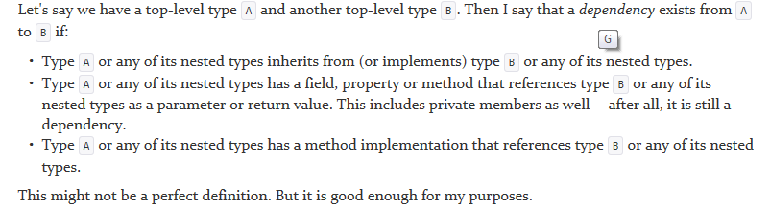
Definition of dependency

Slide 25
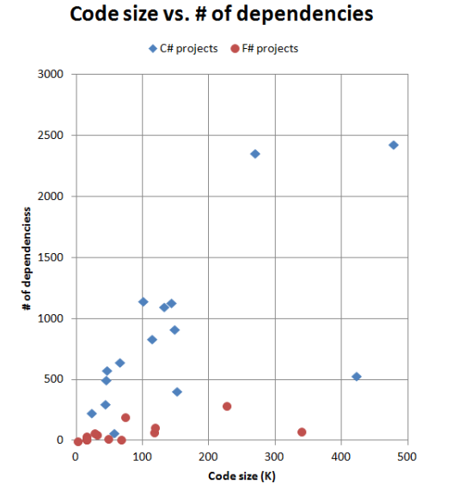
F# code has fewer top-level-type/module dependencies For C#, the number of total dependencies increases with project size. Each top-level type depends on 3-4 others, on average For F# each F# type/module depends on no more than 1-2 others, on average Let’s take a look at the distribution of dependencies…

Slide 26
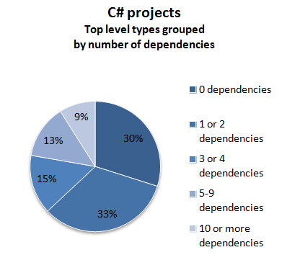
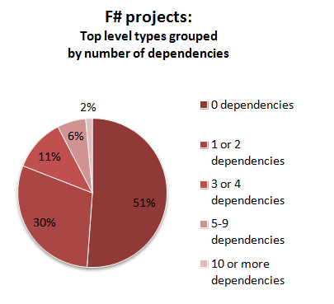

Slide 27
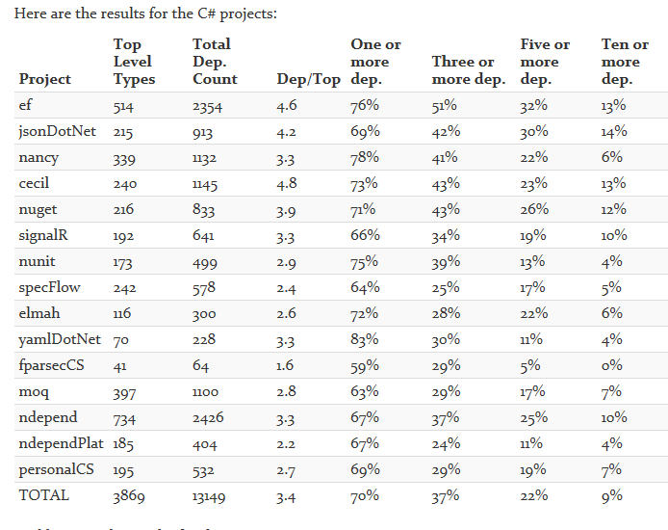

Slide 28
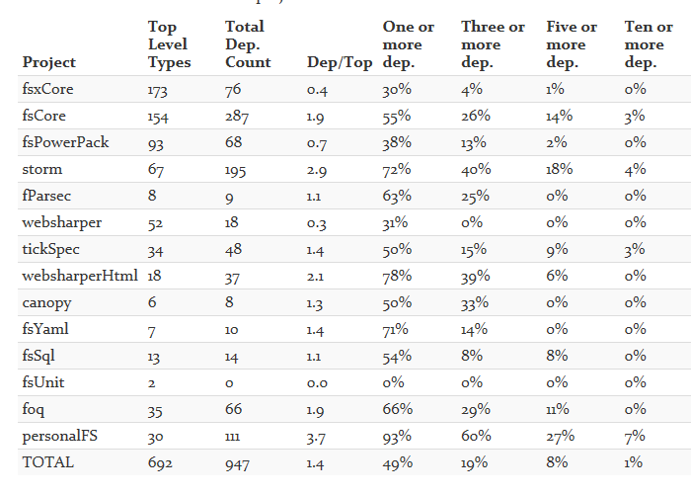

Slide 29
Let’s compare two similar projects…

Slide 30
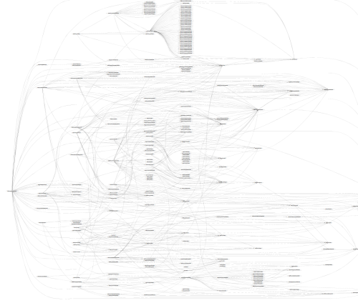
SpecFlow (F#)

Slide 31
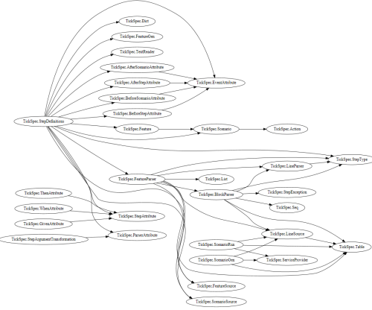
TickFlow (F#)

Slide 32
Similar feature set – the code is organized differently. It highlights some of the differences between OO design and functional design.
SpecFlow is well designed, and a useful library. It uses good OOD and TDD practices:
TestRunnerManager, ITestRunnerManager
"listener" classes and interfaces
"provider" classes and interfaces
"comparer" classes and interfaces…..
TickSpec uses no interfaces at all:
no "listeners", "providers" or "comparers“
where needed the role they play is fulfilled by functions

Slide 33
What about circularity?

Slide 34
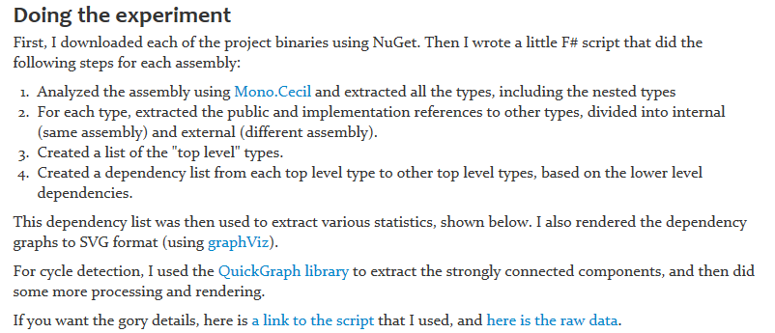
Methodology

Slide 35
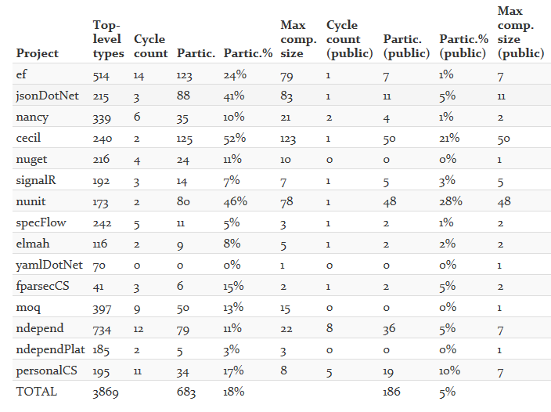

Slide 36
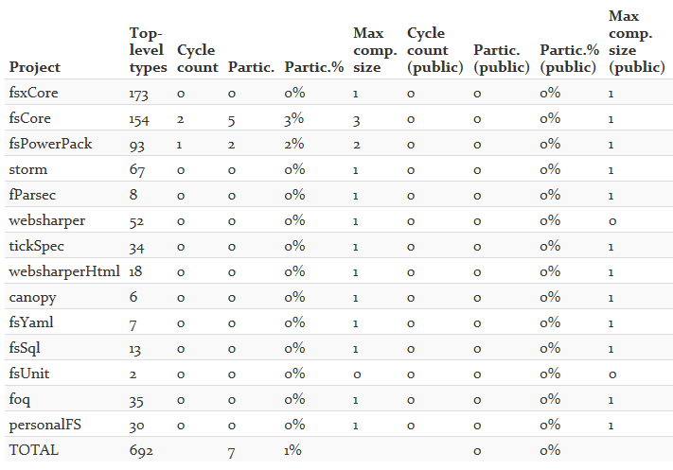

Slide 37
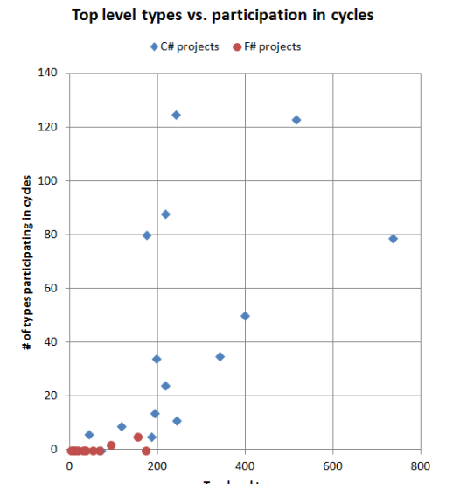
Why the difference between C# and F#?
In C#, there is nothing stopping you from creating cycles. In fact, you have to make a special effort to avoid them.
In F#, you can't easily create cycles at all.

Slide 38
Circularity as it really is…

Slide 39
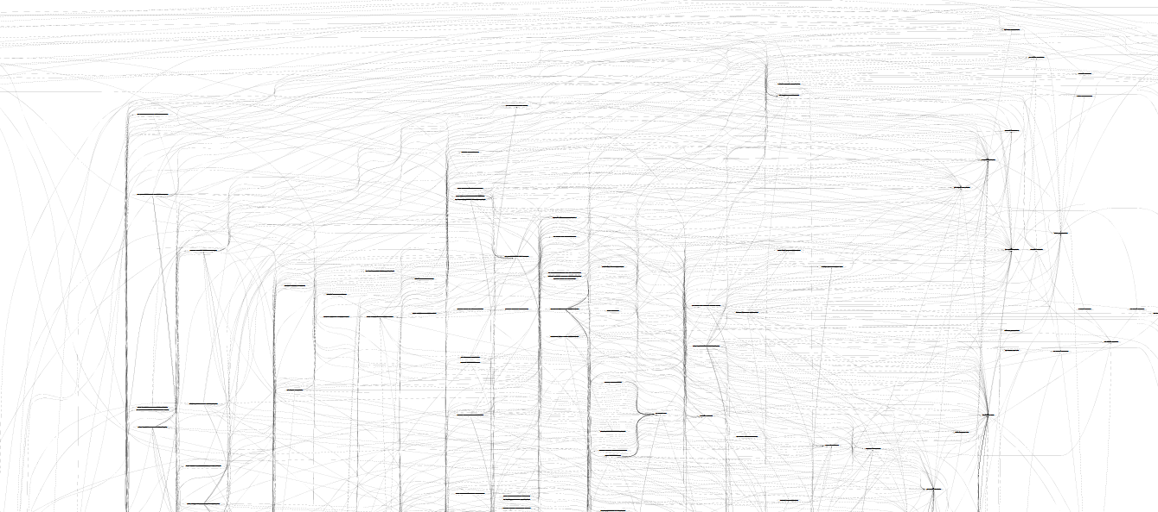
Microsoft Entity Framework
TickFlow

Slide 40
(and that’s just 1/4 of the graph…)

Slide 41
Conclusion…. In theory and in practice, unmoderated intra-assembly cycles are a disaster Language mechanisms that enforce layering are necessary and good

Slide 42
The really hard question: Unmoderated cycles are like crack How do we help an utterly addicted industry? (Whether via OO, FP or other languages?)

Slide 43
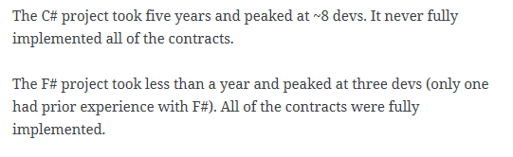
A related analysis (Simon Cousins, Energy Sector)
350,000
lines of C# OO
by offshore team
30,000
lines of robust F#, with
parallel +more features
An application to evaluate the revenue due from Balancing Services contracts in the UK energy industry
http://simontcousins.azurewebsites.net/does-the-language-you-use-make-a-difference-revisited/

Slide 44
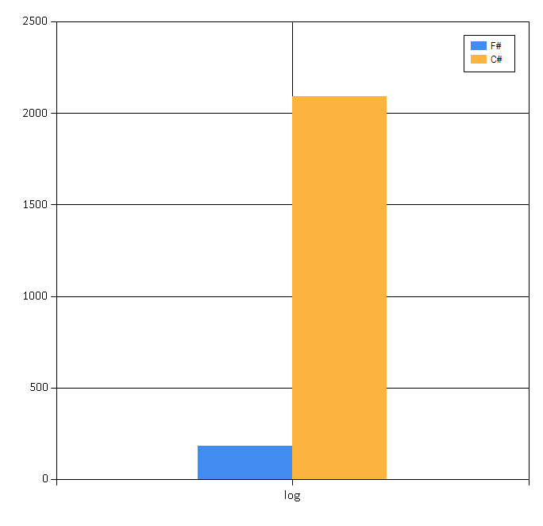
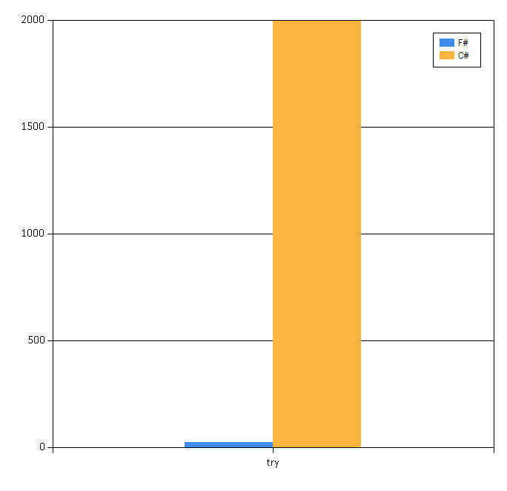
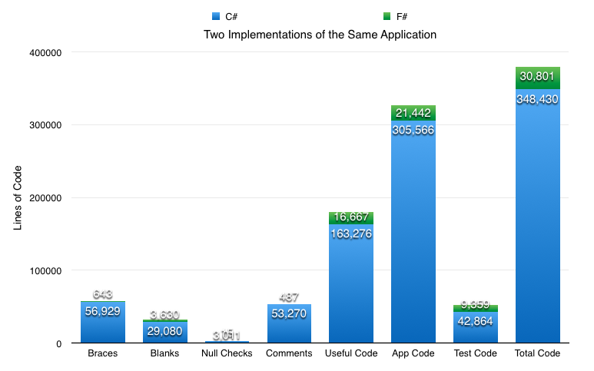
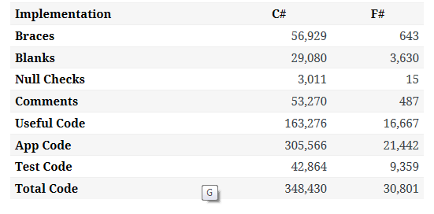

Slide 45
Other F# Topics
F# Basics
F# for Cloud Data
F# for DSLs
F# for GPUs
F# for Testing
F# + R
F# for Data Science
F# Data Integration through Type providers

Slide 46

F# is open source, cross-platform, community-oriented fsharp.org meetup.com/FSharpLondon #fsharp on Twitter
Questions?

Slide 47
In C#, there is nothing stopping you from creating cycles
A perfect example of accidental complexity.
In fact, you have to make a special effort to avoid them.
In F#, of course, it is the other way around. You can't easily create cycles at all.

Slide 48
In Summary
F#
The safe choice for functional-first
Unbeatable data integration
Visual F# - tooling you can trust from Microsoft
Open, cross-platform, strongly typed, efficient, rock-solid stable

